Slide 1
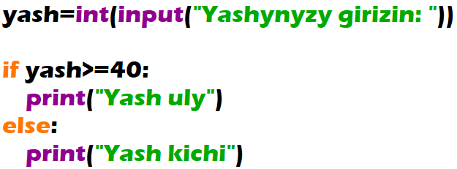

Ask from a user the age. If the user is older than or equal to 40 output “You are old”, else “You are young”

Slide 2
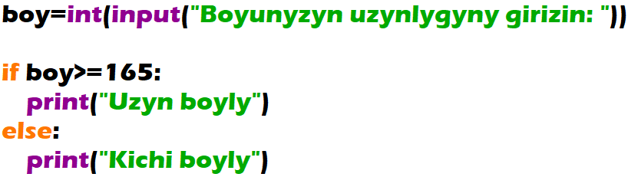

Get from user his height. If the height is higher than or equal to 165 sm “You are tall”, else “You are short”

Slide 3
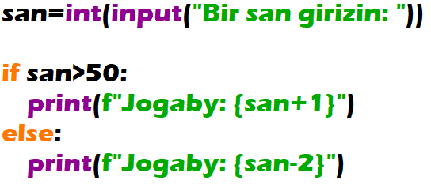

Get from user a number. If the number is higher than 50, then add 1 to that number, else minus 2 from that number. Output the gotten number.

Slide 4
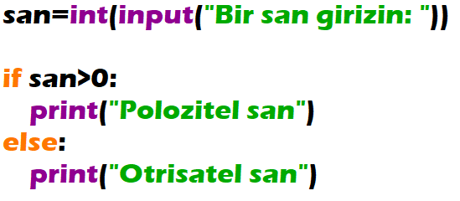

By user given a number. If the number is positive then the program outputs: “The number is positive”. But if the number is negative then the program outputs: “The number is negative”.

Slide 5
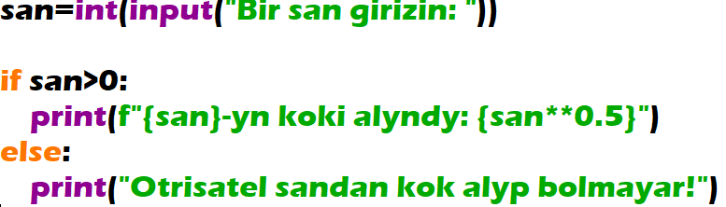

Ulanyjydan bir san almaly we alnan sanyň köküni hasaplamaly. Emma otrisatel sandan kök alyp bolmaýandygyny göz öňünde tutmaly.

Slide 6
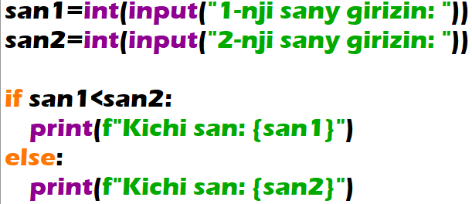
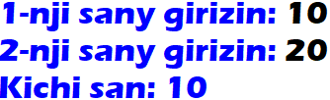
By user given two numbers. And the program outputs the smallest one.

Slide 7
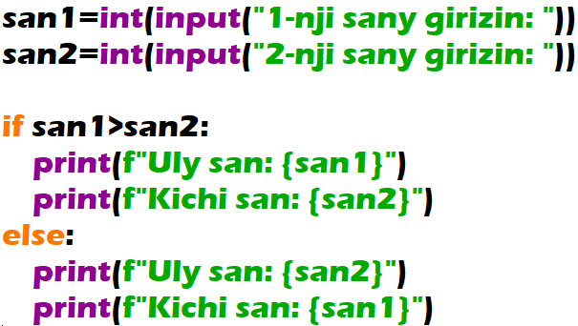
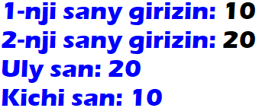
Given two real numbers, output the larger value and then the smaller value of them.

